Slide 1
IntelliSync
Smart Traffic Management System
By Kunj Goel & Tanisha Jauhari [21BCT0038 & 21BCE3566]
09/04/25
Smart Traffic Management System

Slide 2
Table of contents
1.
4.
2.
5.
3.
Overview and introduction
Future Scope
Understanding the problem and solution
Conclusion
Project Flow: How It Works
09/04/25
Smart Traffic Management System
Your Company Name

Slide 3
1.
Overview and introduction
09/04/25
Smart Traffic Management System
Your Company Name

Slide 4
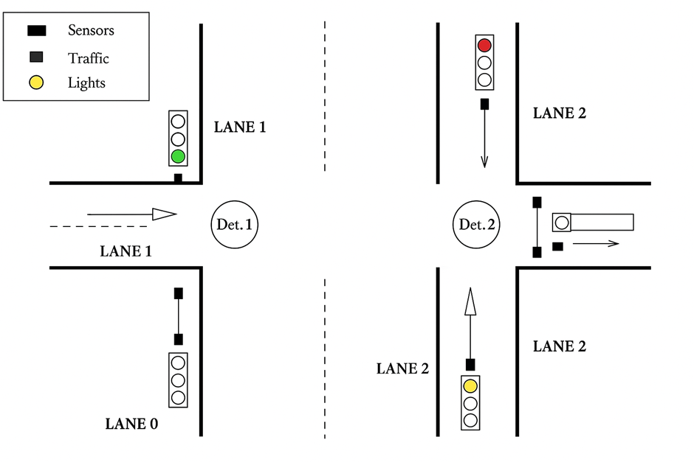
Project Summary
Smart traffic management system combining metal detection and computer vision
Core Innovation
Fault-tolerant architecture ensuring reliable operation even when individual sensing components fail
Key Features
Real-time adaptation
Priority-based signaling
Minimal infrastructure modifications
Multi-sensor verification
09/04/25
Smart Traffic Management System

Slide 5
2. Understanding the Problem & the Solution
09/04/25
Smart Traffic Management System

Slide 6
2. Understanding the Problem and Solution
Problem:
Conventional timer-based traffic signals operate regardless of actual traffic conditions
Modern systems rely on single sensing technologies (camera or sensor only)
Single-point vulnerabilities lead to complete system failures
Inefficient traffic flow increases congestion, pollution, and fuel consumption
Significant waiting time at intersections with unbalanced traffic flow
Solution:
Multi-modal sensing combines metal detection with computer vision
Adaptive signal timing based on real-time traffic density measurements
Fault-tolerant design continues operation if either sensing system fails
Priority-based control algorithm allocates green time proportional to traffic volume
Modular architecture allows flexible deployment and maintenance
09/04/25
Smart Traffic Management System

Slide 7
3. Project Flow: How it works?
09/04/25
Smart Traffic Management System

Slide 8
Operational Workflow:
Detection Phase: Metal sensors continuously monitor vehicle presence at all approaches
Verification Phase:
Single detection: Direct signaling (Yellow → Green)
Multiple detections: Camera rotates to each direction for visual verification
Decision Phase: Computer vision counts vehicles in each active direction
Priority Assignment: Directions ranked by vehicle count (highest first)
Execution Phase: Sequential green signals allocated based on priority order
Continuous Monitoring: System returns to detection phase after completing signal cycle
09/04/25
Smart Traffic Management System

Slide 9
Hardware Aspects
Core Components:
ESP32 Main Controller: Central processing unit and decision-making
Metal Detection Sensors (×2): One per direction, connected to ADC pins 34, 35
WS2812B RGB LEDs (×2): Traffic signals, connected to pins 15, 4
ESP32-CAM Module: Visual verification with OV2640 2MP camera
SG90 Servo Motor: Camera positioning (0°, 45°, 90°, 135° for N, E, S, W)
Companion Laptop: Runs computer vision algorithms for vehicle counting
09/04/25
Smart Traffic Management System

Slide 10
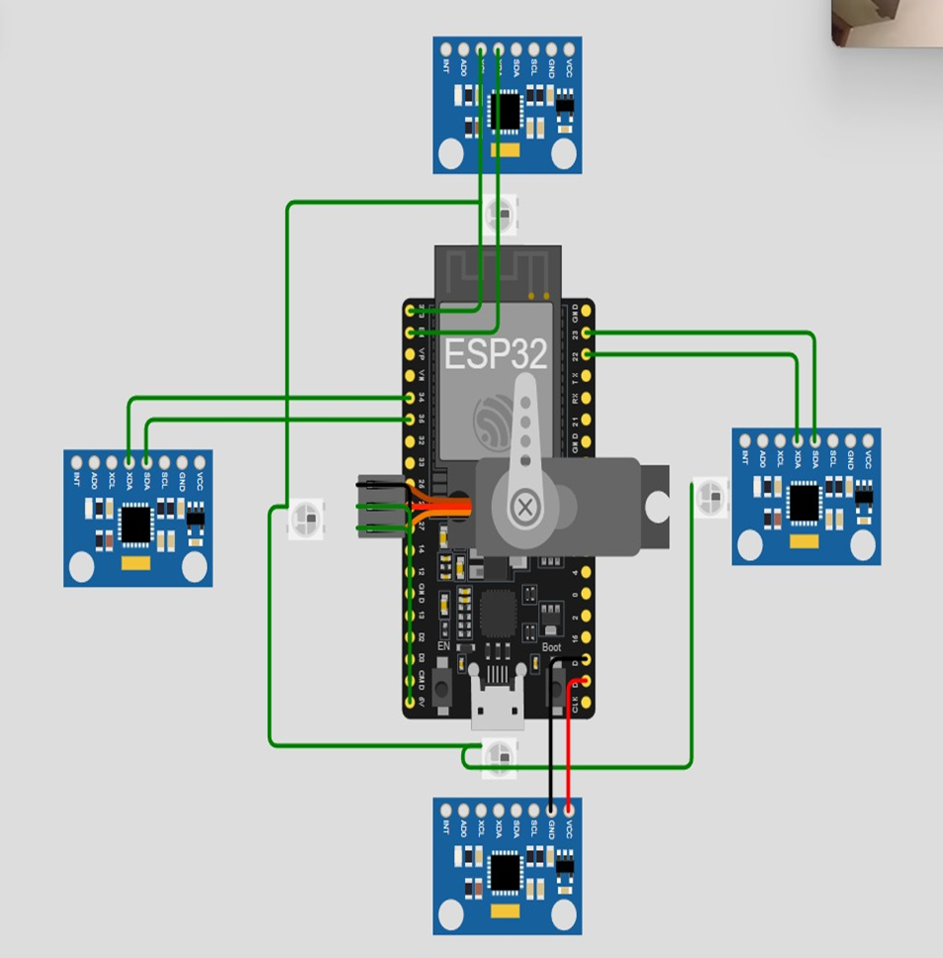
09/04/25
Smart Traffic Management System

Slide 11
Hardware Architecture:
Distributed sensing design with centralized processing
Metal detectors strategically positioned at intersection approaches
Camera mounted centrally with servo for multi-directional viewing
LEDs positioned for optimal visibility to approaching vehicles
Serial communication between ESP32 and laptop for count data exchange
WiFi streaming from ESP32-CAM to laptop for video processing
09/04/25
Smart Traffic Management System

Slide 12
Firmware Aspects
Software Components:
ESP32 Main Controller Firmware:
Sensor polling and threshold detection (analogRead > 1020)
LED control for traffic signaling (Red, Yellow, Green)
Servo positioning control for camera direction
Decision algorithm for priority-based signaling
Serial communication with laptop
09/04/25
Smart Traffic Management System

Slide 13
ESP32-CAM Firmware:
Camera initialization and configuration
WiFi connectivity and server setup
JPEG image streaming to laptop
Computer Vision Software (Python):
Video stream capture from ESP32-CAM
Frame processing and vehicle detection
Count data formatting and transmission
Serial communication with ESP32
09/04/25
Smart Traffic Management System

Slide 14
Key Algorithms:
Direction prioritization based on vehicle counts
Sort algorithm for traffic density ranking
Traffic signal timing allocation
Threshold-based vehicle detection
Fault detection and recovery procedures
09/04/25
Smart Traffic Management System

Slide 15
4. Future Scope
09/04/25
Smart Traffic Management System

Slide 16
Future Scope:
Integration of advanced machine learning models (YOLO, Faster R-CNN)
Edge computing implementation for reduced dependency on external processing
Vehicle classification for different priority assignments
Inter-junction communication for corridor-level optimization
Pedestrian detection and crossing management
Energy optimization with solar power integration
Comprehensive traffic analytics dashboard
09/04/25
Smart Traffic Management System

Slide 17
5. Conclusion
09/04/25
Smart Traffic Management System

Slide 18
Conclusion:
ISTMS offers a viable solution to urban traffic congestion using readily available components
Multi-modal approach addresses critical reliability issues in existing smart traffic systems
Adaptive control provides significant improvements over traditional timer-based signals
Modular architecture ensures easy maintenance, updates, and scalability
Practical implementation path for cities seeking cost-effective traffic management solutions
09/04/25
Smart Traffic Management System

Slide 19
Thank You
09/04/25
Smart Traffic Management System

